Slide 1
Ball on a Plate -MPC-
322AA
Pîndichi Elena
Stăvărache Robert - Antonio

Slide 2
Ce este MPC
1

Slide 3
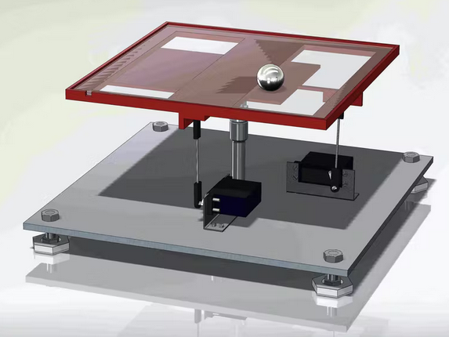


MPC – model predictive control
-> metoda de control
-> cautarea comenzii optime pe un orizont finit (orizont de predictie)
-> minimizarea erorii & magnitudinii comenzii
-> aplicarea primei comenzi din setul gasit
-> reluarea procedurii

Slide 4
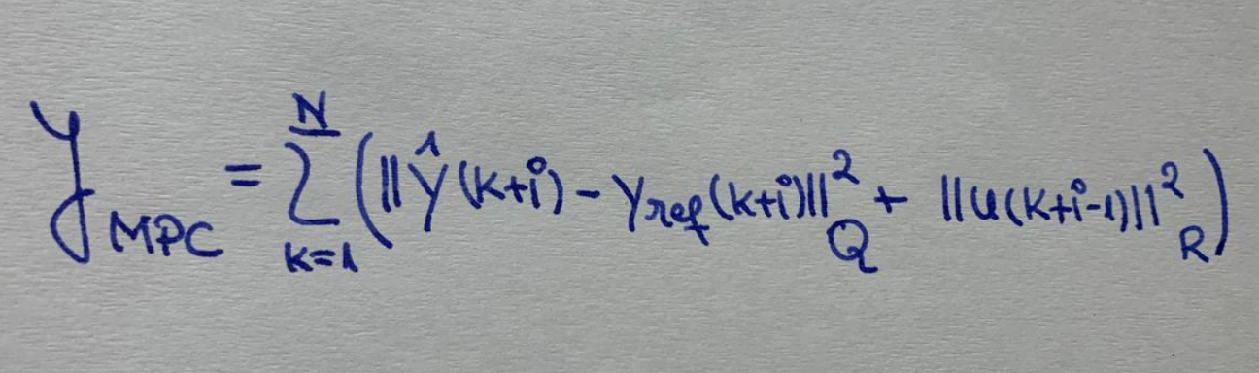
Ce vrem să facem ?
Q, R – matrici pondere
N – orizontul de predictive
i – iteratia MPC

Slide 5
Cum facem?
Modelarea sistemului
Liniarizarea ecuatiilor
Realizarea pe stare
Discretizarea sistemului
Prelucrarea sistemului discret sub forma unei constrangeri matriciale

Slide 6
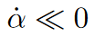
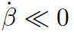
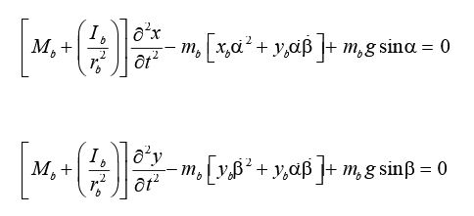
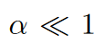
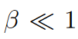
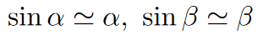
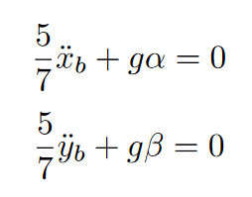
Ecuațiile pentru fiecare axă
si
Iar
Intrucat se pot utiliza aproximarile
Ceea ce conduce la sistemul liniar:
Mb –masa bilei
Ib – momentul de inertie al bilei
rb – raza bilei

Slide 7
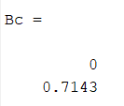
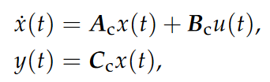
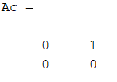
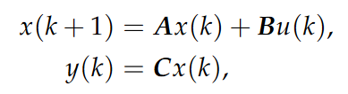
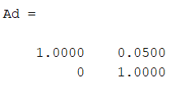
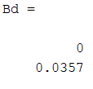
Realizarea pe stare
Ceea ce conduce la sistemul discret (dupa esantionarea de pas Ts = 0.05)

Slide 8
Implementarea optimizarii
2

Slide 9
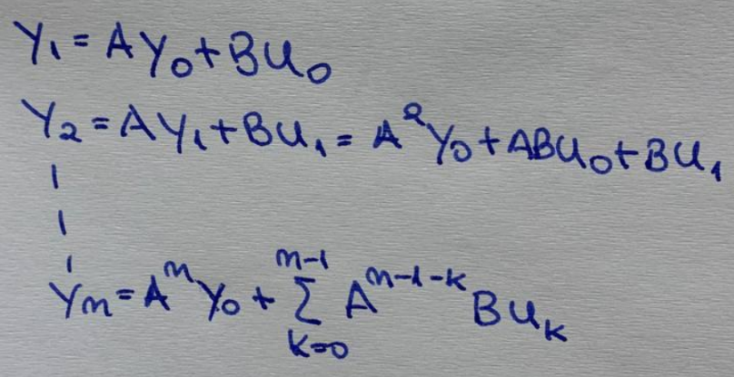
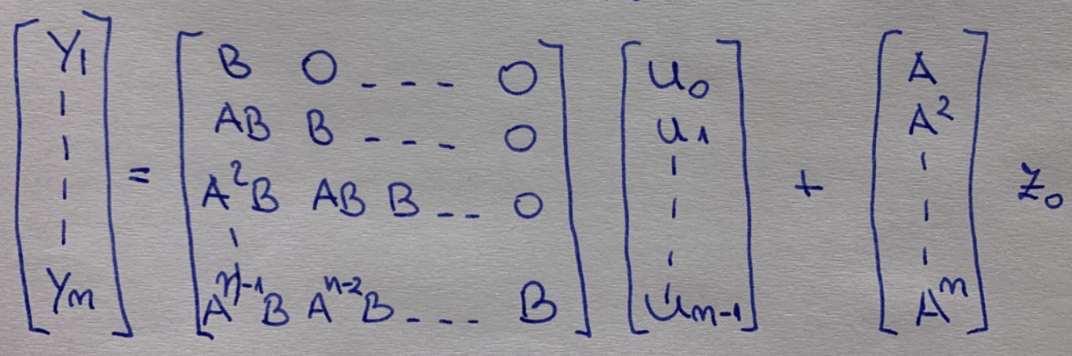
Obtinerea constrangerilor
Matricea M Matricea V

Slide 10
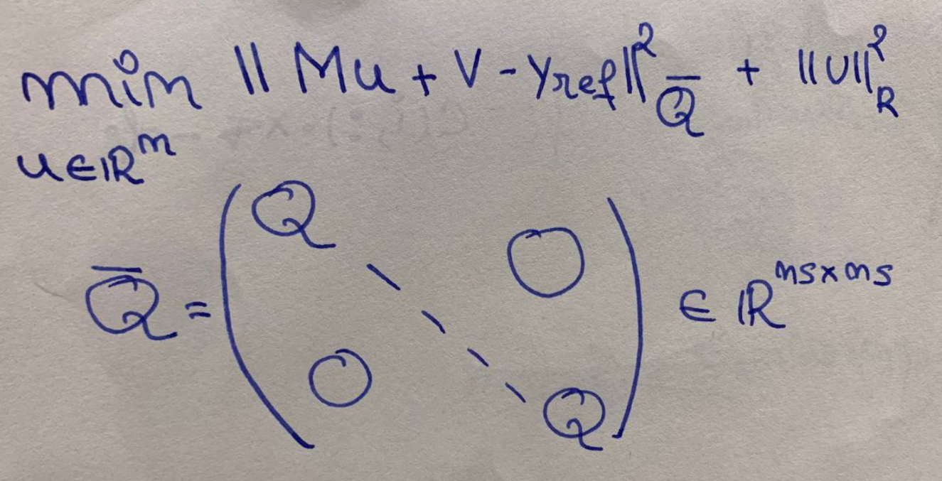
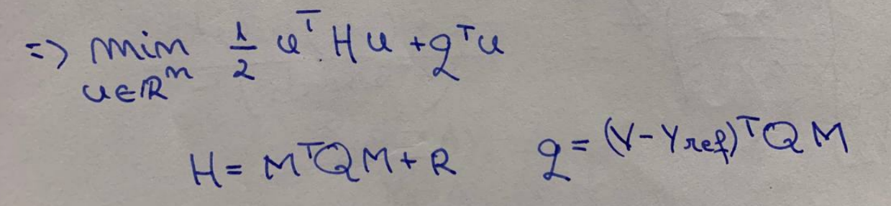
Revenind la functia de cost
Inlocuind iesirea prezisa prin dependenta de intrare, dedusa mai devreme, obtinem:

Slide 11
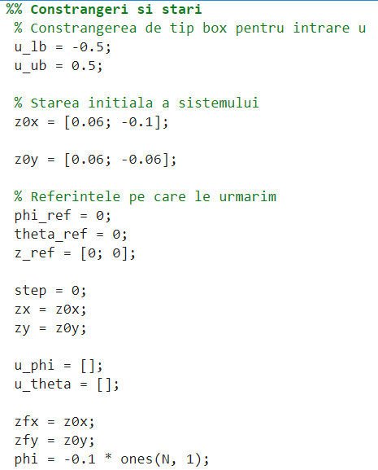
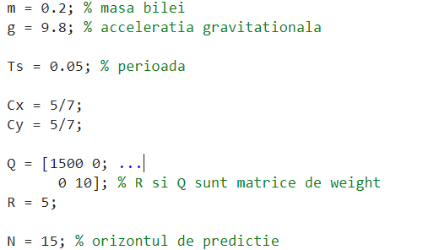
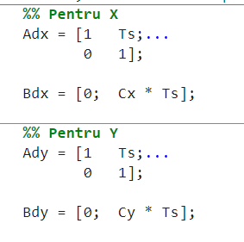
Cod

Slide 12

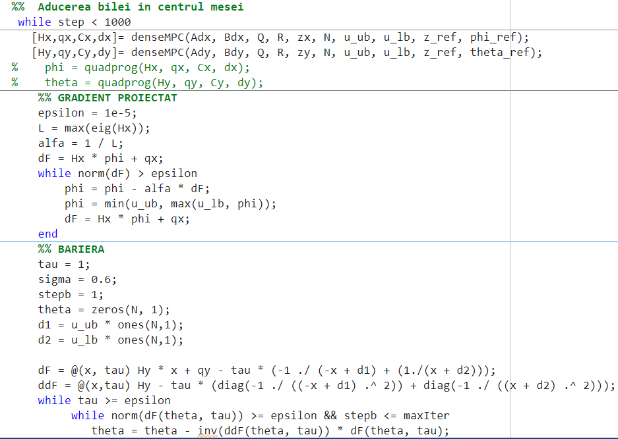

Aducerea bilei în centrul mesei

Slide 13
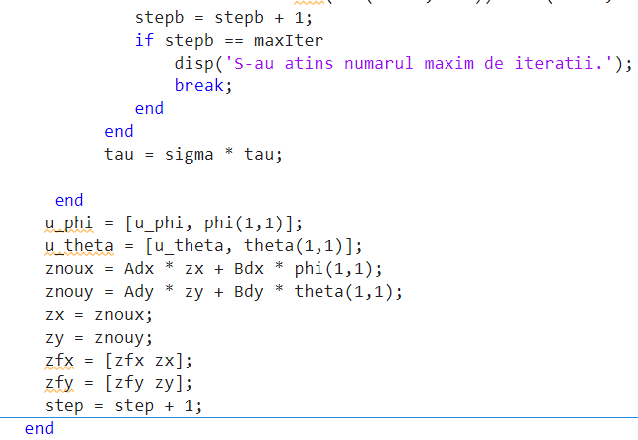
Aducerea bilei în centrul mesei

Slide 15
Metoda Gradient Proiectat
Problemele de control optimal incearca sa minimizeze functia:
Q, R – matrice de greutate
Np – orizontul de predictive
Nu – orizontul de control
K – numarul probei

Slide 16

Demo
You can replace the image on the screen with your own work. Right-click on it and then choose "Replace image" so you can add yours

Slide 17
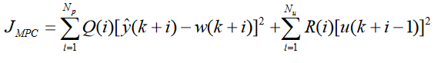
Ce vrem să facem ?
Problemele de control optimal incearca sa minimizeze functia:
Q, R – matrice de greutate
Np – orizontul de predictive
Nu – orizontul de control
K – numarul probei

Slide 18

A picture always reinforces the concept
Images reveal large amounts of data, so remember: use an image instead of a long text. Your audience will appreciate it

Slide 19
Did you know this?
Despite being red, Mars is actually a cold place. It’s full of iron oxide dust. It’s the fourth planet from the Sun and the second-smallest in the Solar System, being larger than only Mercury. Mars carries the name of the Roman god of war

Slide 20
Did you know this?
Despite being red, Mars is actually a cold place. It’s full of iron oxide dust. It’s the fourth planet from the Sun and the second-smallest in the Solar System, being larger than only Mercury. Mars carries the name of the Roman god of war

Slide 21
Ce vrem să facem ?
Problemele de control optimal incearca sa minimizeze functia:
Q, R – matrice de greutate
Np – orizontul de predictive
Nu – orizontul de control
K – numarul probei

Slide 22
Contents of this template
Here’s what you’ll find in this Slidesgo template:
A slide structure based on a presentation for education, which you can easily adapt to your needs. For more info on how to edit the template, please visit Slidesgo School or read our FAQs.
An assortment of graphic resources that are suitable for use in the presentation can be found in the alternative resources slide.
A thanks slide, which you must keep so that proper credits for our design are given.
Two resources slides, where you’ll find links to all the elements used in the template.
Instructions for use.
Final slides with:
The fonts and colors used in the template.
A selection of illustrations. You can also customize and animate them as you wish with the online editor. Visit Storyset to find more.
More infographic resources, whose size and color can be edited.
Sets of customizable icons of the following themes: general, business, avatar, creative process, education, help & support, medical, nature, performing arts, SEO & marketing, and teamwork.
You can delete this slide when you’re done editing the presentation.

Slide 23
Table of contents
01
02
03
Parallel and perpendicular
Lines cut by a transversal
Proving lines are parallel
04
05
Slopes of parallel and perpend. lines
Writing linear equations
You can describe the topic of the section here
You can describe the topic of the section here
You can describe the topic of the section here
You can describe the topic of the section here
You can describe the topic of the section here

Slide 24
—Someone famous
“This is a quote, words full of wisdom that someone important said and can make the reader get inspired.”

Slide 25
Features of the topic
Neptune
Jupiter
Mercury
Neptune is the farthest planet from the Sun
Jupiter is the biggest planet of them all
Mercury is the closest planet to the Sun

Slide 26
9h 55m 23s
333,000
386,000 km
Jupiter’s rotation period
The Sun’s mass compared to Earth’s
Distance between Earth and the Moon

Slide 27
Practical uses of this subject
Jupiter
Neptune
Saturn
Mars
Jupiter is the biggest planet in the Solar System
Neptune is the farthest planet from the Sun
Saturn is a gas giant and has several rings
Despite being red, Mars is actually a cold place

Slide 28
Demo
You can replace the image on the screen with your own work. Right-click on it and then choose "Replace image" so you can add yours

Slide 29
Problem vs solution
Problem
Solution
Neptune is the farthest planet from the Sun and the fourth-largest in the Solar System
Despite being red, Mars is actually a very cold place. It’s full of iron oxide dust

Slide 30
Process
Step 1
Jupiter is the biggest planet of them all
Step 3
Venus is the second planet from the Sun
Step 5
Mercury is the closest planet to the Sun
Step 2
Marth is actually a very cold place
Step 4
Neptune is far away from Earth

Slide 31
Types of lines
Obliques
Horizontal
Vertical
Parallel
Perpendicular
Jupiter is the biggest planet
Venus has a beautiful name
Saturn is the ringed planet
Neptune is very far away from us
Mercury is the smallest planet

Slide 32
Steps to solve linear equations
Mars
Saturn
Jupiter
Venus
Mercury
Neptune
Despite being red, Mars is a very cold place
Saturn is a gas giant and has several rings
Jupiter is the biggest planet in the Solar System
Venus is the second planet from the Sun
Mercury in the closest planet to the Sun
Neptune is the farthest planet from the Sun

Slide 33
Assignment
Mercury
Mars
Venus
Neptune
Jupiter
Mercury is the closest planet to the Sun
Despite being red, Mars is a cold place
Venus is the second planet from the Sun
Neptune is very far away from Earth
Jupiter is the biggest planet of them all

Slide 34

A picture is worth a thousand words

Slide 35
Awesome words

Slide 36
131,019
Big numbers can catch your audience’s attention

Slide 37
Objectives of the lesson
List here the objectives
List here the objectives
List here the objectives
List here the objectives
List here the objectives
List here the objectives
List here the objectives
List here the objectives
List here the objectives
List here the objectives
List here the objectives
List here the objectives
List here the objectives
List here the objectives
List here the objectives
List here the objectives
List here the objectives
List here the objectives
List here the objectives
List here the objectives
List here the objectives
List here the objectives
List here the objectives
List here the objectives

Slide 38
This is a map
Mercury
Mercury is the closest planet to the Sun
Marth
Despite being red, Mars is a very cold place

Slide 39
Exercise: fill the missing angles
Find the missing angles with the given information.
Note that angles are not drawn to scale, so do not try to measure them:
110
-
-
75
-
88

Slide 40
Exercise: complete the table
Write the equation in the slope-intercept from of the line that is perpendicular to the graph of each equation and passes through the given point
Equation | Point | Perpendicular equation
y=-5x+1 | (2 , -1)
y=2x-3 | (-5 , 3)
y=-4x-2 | (4 , -4)
7y+4x=3 | (-4 , -7)

Slide 41
Exercise: parallel or perpendicular?
Are the lines L1 and L2 passing through the given pairs of points parallel, perpendicular or neither parallel nor perpendicular?
a.
L1: (1 , 2) , (3 , 1)
c.
L1: (2 , -1) , (5 , -7)
L2: (0 , -1) , (2 , 0)
L2: (0 , 0) , (-1 , 2)
Write here the type
Write here the type
b.
L1: (0 , 3) , (3 , 1)
d.
L1: (1 , 0) , (2 , 0)
L2: (-1 , 4) , (-7 , -5)
L2: (5 , -5) , (-10 , -5)
Write here the type
Write here the type

Slide 42
Exercise: pairs of points
Find the slope of the line passing through the pairs of points and describe the line as rising, falling, horizontal or vertical
8
(2 , 1)
(2 , 1)
6
a.
c.
(4 , 5)
(-3 , 1)
4
Write here the type
Write here the type
2
0
b.
(1 , 0)
d.
(-1 , 2)
-2
(3 , -5)
(-1 , -5)
-4
Write here the type
Write here the type
-6
-8
-8
-6
-4
-2
0
2
4
6
8

Slide 43
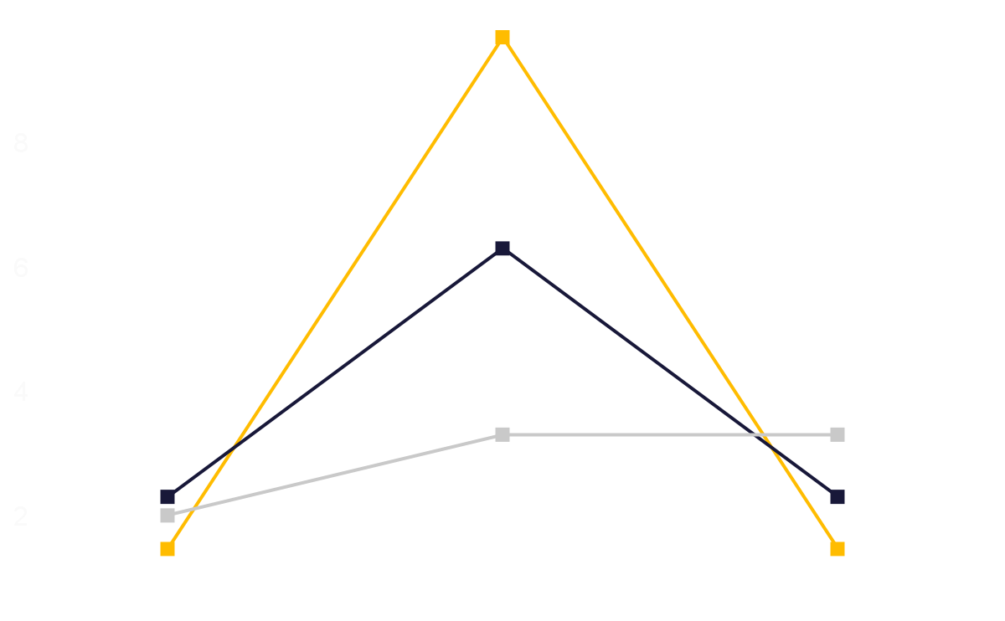
Maybe you need a graph
10
Saturn
Saturn is a gas giant and the ringed planet
8
Jupiter
6
Jupiter is the biggest planet of them all
4
Venus
2
Venus is the second planet from the Sun
2
4
6
8
10
Follow the link in the graph to modify its data and then paste the new one here. For more info, click here

Slide 44


Our team
Jade Forest
Austin Jones
You can talk a bit about this person here
You can talk a bit about this person here

Slide 45
Thanks!
Do you have any questions?
addyouremail@freepik.com
+91 620 421 838
yourwebsite.com
Please keep this slide for attribution

Slide 46
Alternative resources
Photos:
Positive aged math teacher standing with chalk
Smiley teacher holding a bunch of books and an apple with copy space
Confident aged math teacher looking at class
Female teacher standing
Vectors:
Flat geometric background

Slide 47
Resources
Photos:
Aged math teacher thinking next to chalkboard
Smiling math teacher greeting auditorium
Senior male professor explaining and writing on green chalkboard
English teacher doing her class with a whiteboard
Vectors:
Flat design geometric background

Slide 48
Resources

Slide 49
Instructions for use
In order to use this template, you must credit Slidesgo by keeping the Thanks slide.
You are allowed to:
- Modify this template.
- Use it for both personal and commercial projects.
You are not allowed to:
- Sublicense, sell or rent any of Slidesgo Content (or a modified version of Slidesgo Content).
- Distribute Slidesgo Content unless it has been expressly authorized by Slidesgo.
- Include Slidesgo Content in an online or offline database or file.
- Offer Slidesgo templates (or modified versions of Slidesgo templates) for download.
- Acquire the copyright of Slidesgo Content.
For more information about editing slides, please read our FAQs or visit Slidesgo School:
https://slidesgo.com/faqs and https://slidesgo.com/slidesgo-school

Slide 50
Instructions for use (premium users)
As a Premium user, you can use this template without attributing Slidesgo or keeping the "Thanks" slide.
You are allowed to:
Modify this template.
Use it for both personal and commercial purposes.
Hide or delete the “Thanks” slide and the mention to Slidesgo in the credits.
Share this template in an editable format with people who are not part of your team.
You are not allowed to:
Sublicense, sell or rent this Slidesgo Template (or a modified version of this Slidesgo Template).
Distribute this Slidesgo Template (or a modified version of this Slidesgo Template) or include it in a database or in any other product or service that offers downloadable images, icons or presentations that may be subject to distribution or resale.
Use any of the elements that are part of this Slidesgo Template in an isolated and separated way from this Template.
Register any of the elements that are part of this template as a trademark or logo, or register it as a work in an intellectual property registry or similar.
For more information about editing slides, please read our FAQs or visit Slidesgo School:
https://slidesgo.com/faqs and https://slidesgo.com/slidesgo-school

Slide 51
Fonts & colors used
This presentation has been made using the following fonts:
Kanit
(https://fonts.google.com/specimen/Kanit)
Alegreya Sans
(https://fonts.google.com/specimen/Alegreya+Sans)
#000000
#ffffff
#fafafa
#ffbc00
#181839
#c9c9c9

Slide 52





Storyset
Create your Story with our illustrated concepts. Choose the style you like the most, edit its colors, pick the background and layers you want to show and bring them to life with the animator panel! It will boost your presentation. Check out how it works.
Pana
Amico
Bro
Rafiki
Cuate

Slide 53
Use our editable graphic resources...
You can easily resize these resources without losing quality. To change the color, just ungroup the resource and click on the object you want to change. Then, click on the paint bucket and select the color you want. Group the resource again when you’re done. You can also look for more infographics on Slidesgo.

Slide 56
JANUARY
FEBRUARY
MARCH
APRIL
MAY
JUNE
PHASE 1
Task 1
Task 2
PHASE 2
Task 1
Task 2
JANUARY
FEBRUARY
MARCH
APRIL
PHASE 1
Task 1
Task 2

Slide 59
...and our sets of editable icons
You can resize these icons without losing quality.
You can change the stroke and fill color; just select the icon and click on the paint bucket/pen.
In Google Slides, you can also use Flaticon’s extension, allowing you to customize and add even more icons.

Slide 60
Educational Icons
Medical Icons

Slide 61
Business Icons
Teamwork Icons

Slide 62
Help & Support Icons
Avatar Icons

Slide 63
Creative Process Icons
Performing Arts Icons

Slide 64
Nature Icons

Slide 65
SEO & Marketing Icons

Slide 66


